Slide 1
CS5551 Advanced Software Engineering Test-Driven Development (TDD) & Unit Testing
References: Ersan BİLİK, Software Unit Testing and Test Driven Development with nUnit framework

Slide 2
What is Test Driven Development?
TDD = Test First Development + Refactoring
Make it Fail
No code without a failing test
Make it Work
As simply as possible
Make it Better
Refactor

Slide 3
Development Cycle
add a test
[Pass]
run the tests
[Development
continues]
make it
better (refactor)
[Fail]
run the tests
[Development stops]

Slide 4
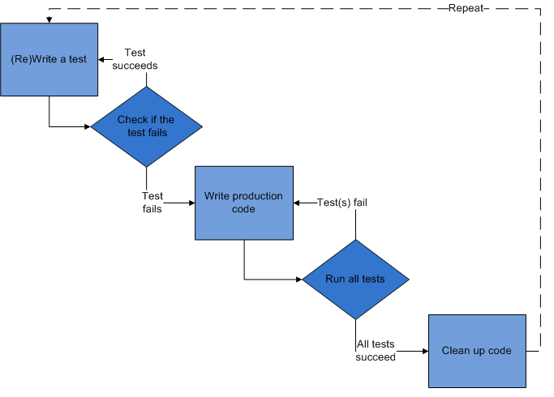
2. Run the new test
4. Run test until passed
1. Before implementing function, add a test based on features and user stories
5. Refactor the code and optimize the structure
3. Improvement with codes and function
https://en.wikipedia.org/wiki/Test-driven_development

Slide 5
Test Driven Development (TDD)
It is a software development process that relies on the repetition of a very short development cycle
actually, itself is not a lifecycle model, but an approach for implementation phase for agile software lifecycles.
it is a bottom-up approach.
write tests first, then code necessary instructions to pass your tests.

Slide 6
Write tests first ?
yes, first write a test case.
then build it.. it will fail because no code written to pass the test
implement your code as long as test case is passed.
then think about it, how to do it better ?
Repetition of a very short development cycle
write an test case based on features or user story before implementation
produce the minimum amount of code to pass that test
refactor and optimize the new code

Slide 7
What is Unit Testing?
test: a means of determining the presence, quality or truth of something
determining “the unit” works as it is promised to?
determining the quality of “the unit” ?
determining the truth about “the unit” ?
unit : smallest testable part of an application
an individual program
a function
a procedure
a method..
depends on your viewpoint !

Slide 8
What is Unit Testing? (cont)
Unit Testing : a procedure used to validate that individual units of source code are working properly.
unit testing itself, is a procedure
unit testing applies to individual units
unit tests build-on to source code
to ensure source code is working properly

Slide 9
What about cons and pros ?
PROS
CONS
isolation of units
refactoring code
simplifies integration
documentation
seperation of interface from implementation
a good habit: motivator for decoupled, cohesive code bodies, refactored with design patterns..
go to definition: it applies to individual units, therefore it can not guaranty the overall system will work !
it only shows the presence of errors, not absence of errors..

Slide 10
How to apply it ?
Manually..
step by step instructional document..
Automated tools
frameworks are available..
usually called xUnit frameworks.. (JUnit, NUnit, JsUnit, CppUnit, DUnit, VBUnit, RUnit, PyUnit, Sunit, HtmlUnit, …)
Javascript – Karma, Jasmin, etc.
Jasmin: Behavior Driven Development (BDD)

Slide 11
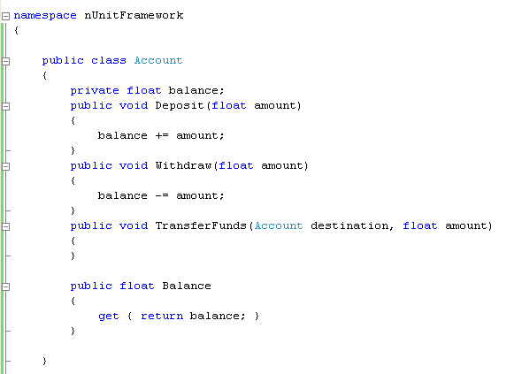
Example: a simple Account Class

Slide 12
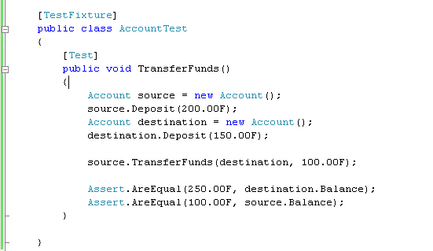
Example: it’s Unit Test

Slide 13
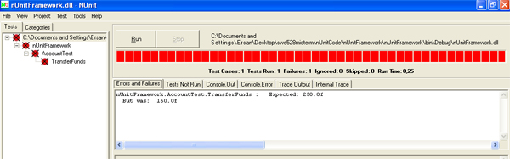
Now, run nUnit GUI to check results

Slide 14
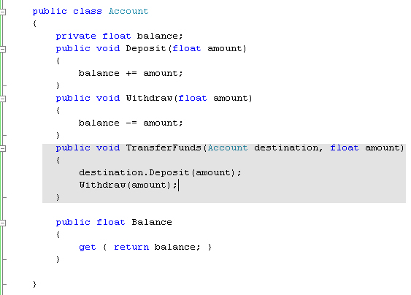
Implement the necessary code..

Slide 15
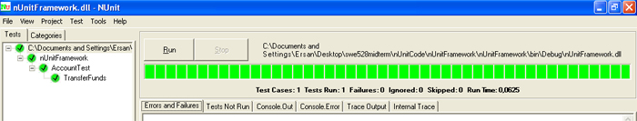
Run the test again..

Slide 16
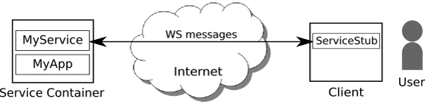
Test with web service
This is a service-oriented architecture
Client communicates with web service
Now we want to test methods in web service

Slide 17
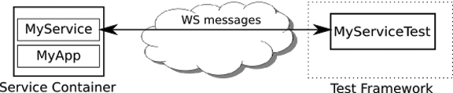
Test with web service
Replace client with service testing code
Let testing code communicate with web service

Slide 18
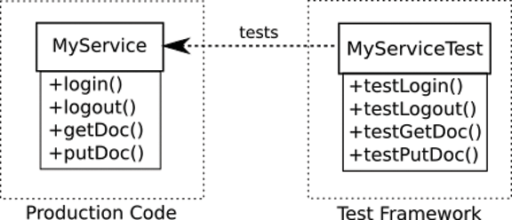
Test with Web Service

Slide 19
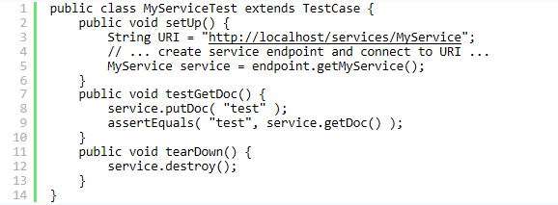

Slide 20
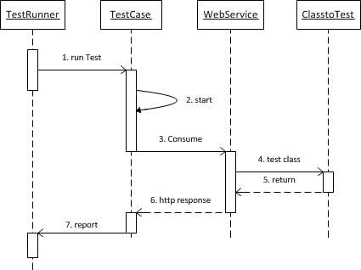
Sequence Diagram

Slide 21
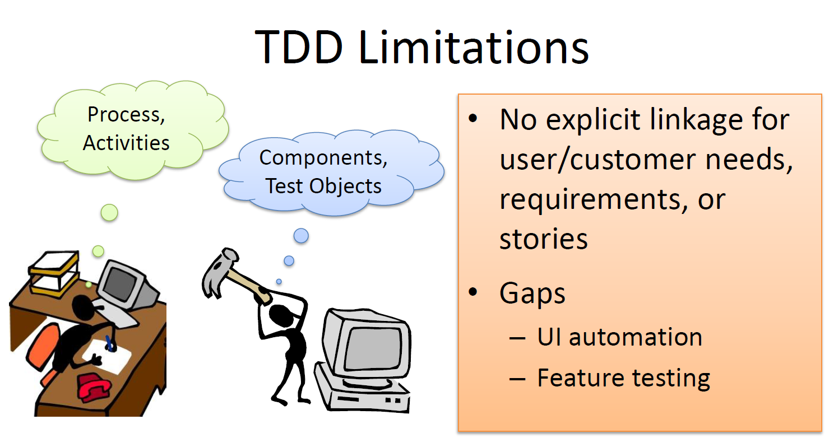
Source:

Slide 22
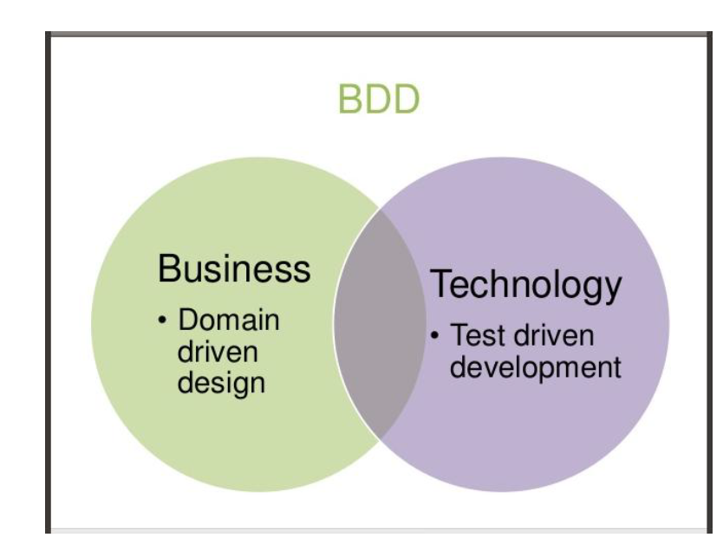
Behavior Driven Development

Slide 23
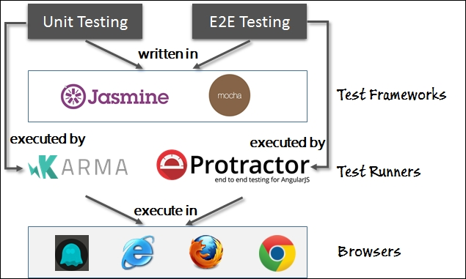
Unit Testing: Jasmine & Karma
http://www.gokhankaradas.com/blog/page/2

Slide 24
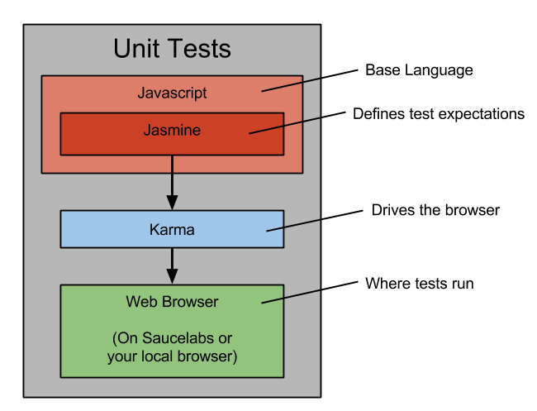
Unit Testing: Jasmine & Karma
https://priv.ly/pages/develop

Slide 25
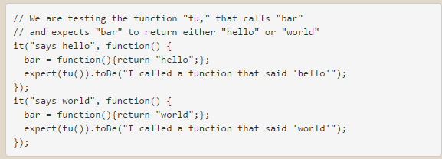
BDD: Jasmine & Karma
Specs: Jasmine
Specs for unit testing are written using a Javascript library called Jasmine. This is essentially a library of functions to make unit testing easier.
Unit Test Runner: Karma
The unit tests run in a variety of web browsers using the Karma test runner, which is a system that opens all the test files in web browsers (Firefox and Chrome with Karma).
Anytime you save a “watched” file, the unit tests will re-run and tell you which tests pass and fail. No more hitting refresh in the browser!
https://priv.ly/pages/develop

Slide 26
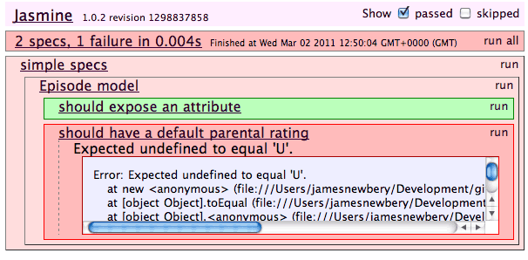
BDD: Jasmin & Karma
Jasmine is a behaviour-driven development (BDD) testing framework for JavaScript. Jasmine allows you to write ‘specs’ (not tests) representing a single example of behaviour that you would like your code to exhibit.
https://tinnedfruit.com/2011/03/03/testing-backbone-apps-with-jasmine-sinon.html

